Slide 1


SONG
RECOMMENDATION
ENGINE (Spotify-replica)
SPOTIFY
Presented by: Milind Kumar Choudhary

Slide 2
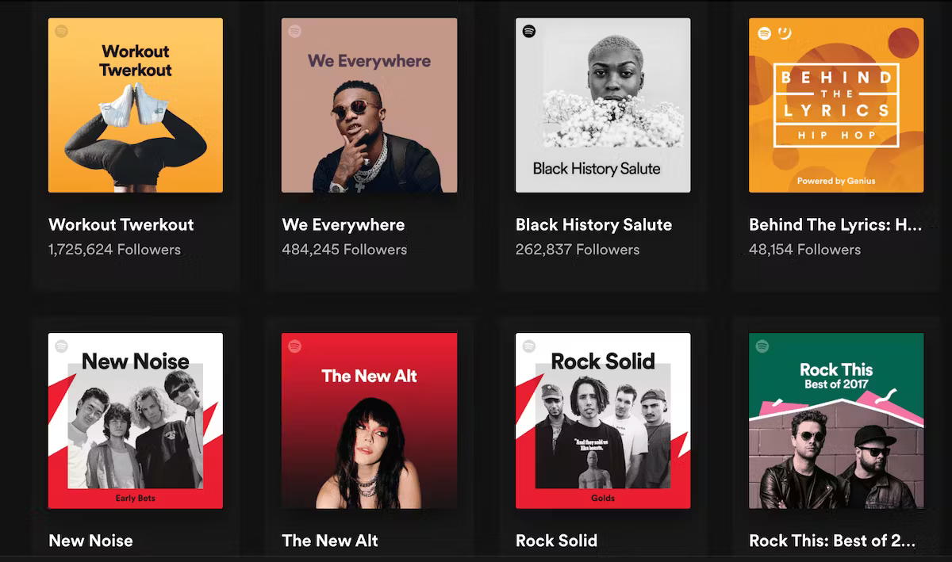
OVERVIEW
01
02
03
About
Methodology
Steps
04
05
06
Recommendations
What’s next?
References

Slide 3
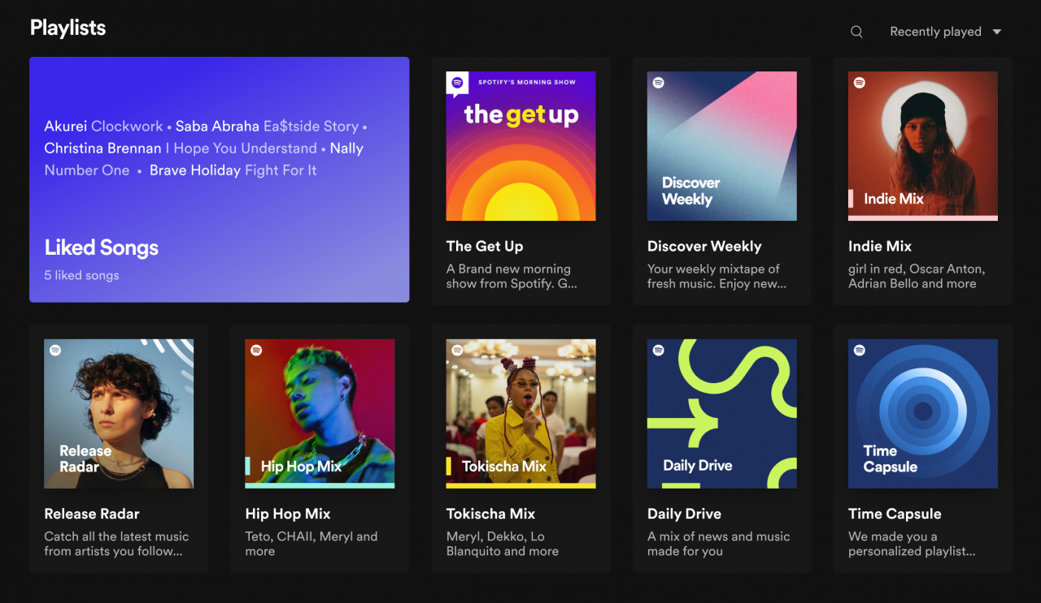



ABOUT
Ever wondered how Spotify predicts a new playlist to a user based on the user's current playlist or how YouTube predicts the following video users might want to watch next? Is this magic?
A music recommendation system is a filtering system that predicts the preference of a user for a particular song based on their past behavior. The system works by analyzing the user’s past listening history and recommending songs that they would probably like to hear in the future

Slide 4



METHODOLOGY
01
ML Algorithm (K-Means)
One way to do this is to use the Spotify dataset, which contains information about songs, artists, and user preferences. I can use this dataset to train a machine learning model that can predict which songs a user might like based on their listening history and other factors.
02
Content-Based Filtering
Another approach is to use content-based filtering, which involves analyzing the characteristics of songs to make recommendations based on those characteristics.
03
Collaborative Filtering
Another approach to building a recommendation engine is to use collaborative filtering, which involves analyzing user behavior to identify patterns and make recommendations based on those patterns.

Slide 5
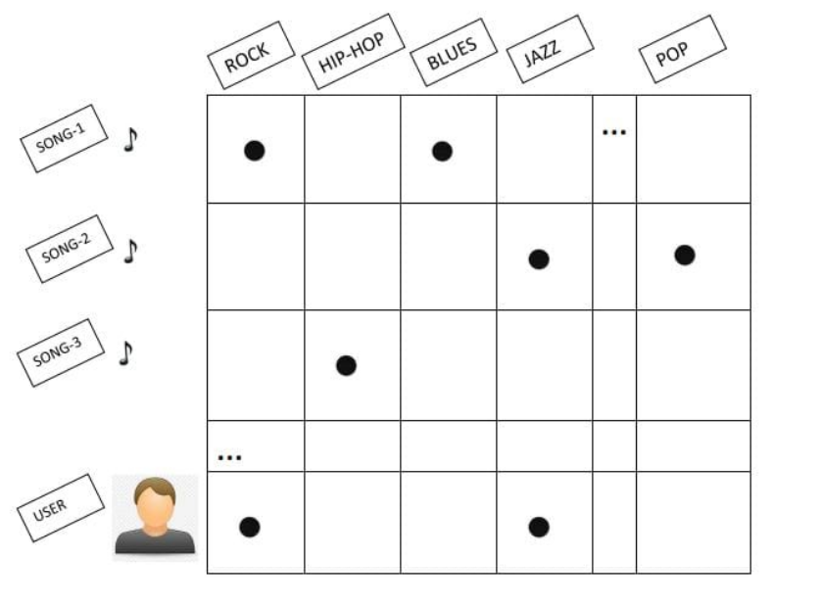
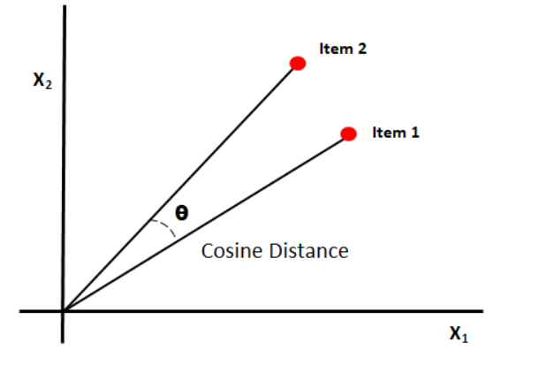
CONTENT-BASED
FILTERING
COSINE SIMILARITY

Slide 6

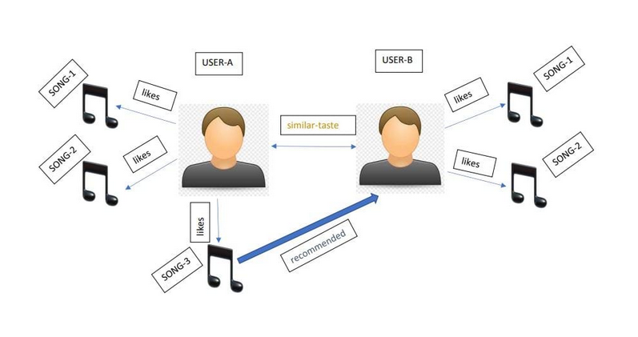
COLLABORATIVE
FILTERING

Slide 7

STEPS
Feature Engineering
In the dataset, we can observe that multiple columns represent the possible features for a song. Out of these, few features are categorical (columns having discrete values) like genre, key, popularity index, etc.
In the next step, I will fetch my Spotify playlist data. To connect to the Spotify Web API, you will need a unique client id and a client secret
Spotify Web API
Playlist Dataframe
Created a new data frame for our playlist using the Spotify song features dataset that we have used.
To perform the cosine similarity between our playlist and the songs not present in our playlist, we will try to summarize our playlist in one vector. This vector will represent our playlist in the feature space, and we will be able to find songs similar to the songs in our playlist.
Playlist Vector
We will perform the cosine similarity between our playlist vector and songs not present in our playlist.
Then we will perform cosine similarity using a Python-based library, Scikit and store the cosine similarity values in a separate column.
Recommendations

Slide 8
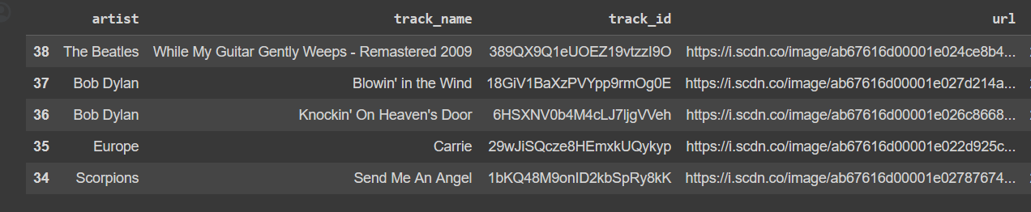
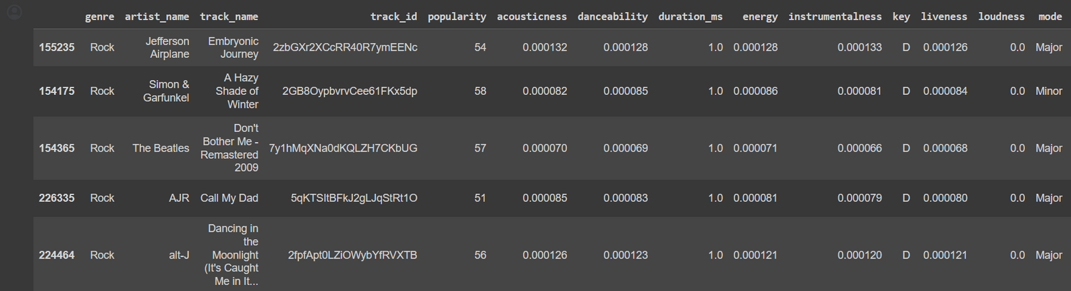
Spotify_features_dataframe
Recommended Playlist (Top 15)

Slide 9


CHALLENGES
Connecting to Spotify Web API
Fetching the playlists from the current user’s account.
A huge dataset needs to have normalization.
Creating Playlist vector

Slide 10



WHAT’S NEXT?
Phase 1
Phase 2
Perform the Content-Based Filtering on the Spotify dataset using the user’s current playlist to recommend a similar playlist
Recommend playlists to a user, using Collaborative Filtering. Where we will match one user’s interest with another and recommend songs.

Slide 11
REFERENCES
https://spotipy.readthedocs.io/en/2.16.1/
https://d3.harvard.edu/platform-rctom/submission/spotify-machine-learning-as-recommendation-engine-and-musical-composer/
https://www.kaggle.com/datasets/zaheenhamidani/ultimate-spotify-tracks-db
https://developers.google.com/machine-learning/recommendation
https://www.section.io/engineering-education/building-spotify-recommendation-engine/

Slide 12


Thank You!
milindkumar.choudhary@pace.edu

